Slide 1
Colella - Moral Support and Performance Table Replication
Summary:
Study examines the importance of moral support for team performance
Focuses on a 2013 Argentinean football legislation that banned visiting team supporters at league games
Findings: Visiting teams were 20% more likely to lose without their supporters
No effect observed in cup games, where visiting team supporters were present.
No evidence of bias from referees, lineups, or market value impacting performance
Moral support is more impactful when team strengths are equal, compensating for monetary disparities
Concludes that moral support is a significant nonmonetary resource, even in highly incentivized environments

Slide 2
Colella - Moral Support and Performance Table Replication
Slide Numbers | Table | Sections to Replicate
5 – 31 | Table 1: Descriptive Statistics | Replication of Panel A & B (Before and after ban)
32 – 46 | Table 2: OLS Estimation | Replication of Models 1, 5 & 6 with robust standard errors
47 – 48 | Table 4: OLS Estimation | Counterfactual Test for Cup Games (Models 1, 5 & 6)
49 – 58 | Table 5: OLS Estimation | Replication for Red Cards and Penalties (Panels B & C)
59 - 65* | Table 6: OLS Estimation | Multivariate Regression with Interaction Terms (Models 1, 5, 6 & 7)
* We will skip this till later class when interaction is covered

Slide 3
Retrieving the Datasets
6. Extract from the ZIP file
7. Rename the folder “Moral Support Data”
8. Ensure that you use the correct data for your operating system (MACOSX or WINDOWS)
9. Within the correct replication folder open the “dta” folder
10. Delete “data_3_lineups”, “data_4_squad_values” and “data_5_lineup_values”
* Only “data_1_liga” and “data_2_copa” are needed to replicate the tables

Slide 4
Retrieving the Datasets
Moral Support and Performance
Author: Colella
Paper: “Moral Support and Performance”
Pages: 15
Click on the paper link above
1. Click on the link https://doi.org/10.1287/mnsc.2021.02906 in the “Supplemental material” section on the bottom of the title page
2. Click “Supplemental materials” on the right
3. Click “HERE”
4. Fill out and submit the form
5. The ZIP file will download automatically

Slide 5
Table 1: Descriptive Statistics
First take a look at Table 1. Summary Statistics in the “Moral Support and Performance” paper
The table is split into two panels. Panel A: League games utilizes the data from “data_1_liga” and Panel B: Cup games uses the “data_2_copa” dataset.
The table is also split into two columns, “Before” and “After”, referring to games played before and after the law banning visiting team fans went into effect.
In order to replicate Table 1 you must create four separate descriptive statistics tables with mean and standard deviation for each respective panel and column.
The following steps will allow you to replicate Table 1 in SPSS

Slide 6
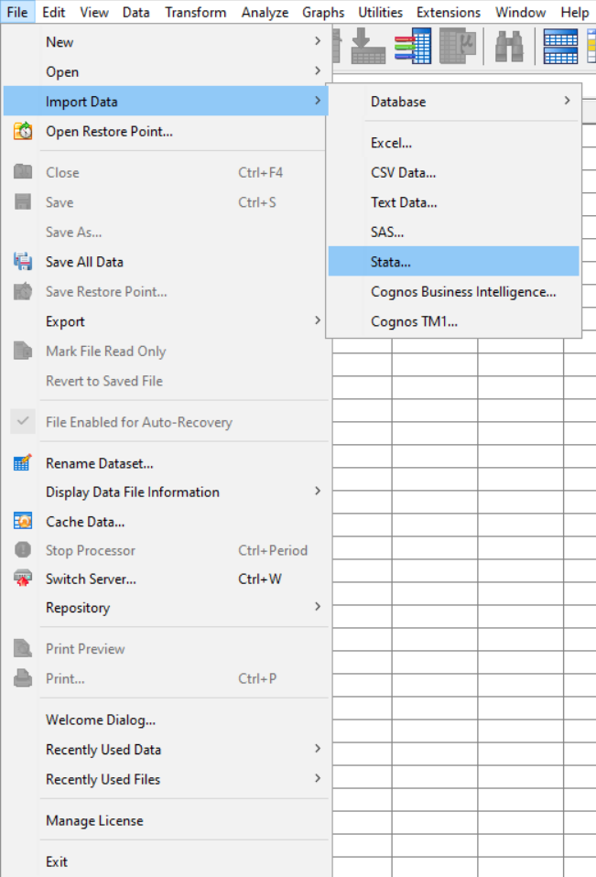
Table 1: Descriptive Statistics
Import the Stata “data_1_liga” dataset from the “Moral Support Data” folder
1. Open SPSS
2. Click “File” on the top left
3. Hover over “Import Data”
4. Click “Stata”
Note: We imported and converted the two datasets from Stata to SPSS for you, so you only need to click “Open” from the “File” menu to access them.

Slide 7
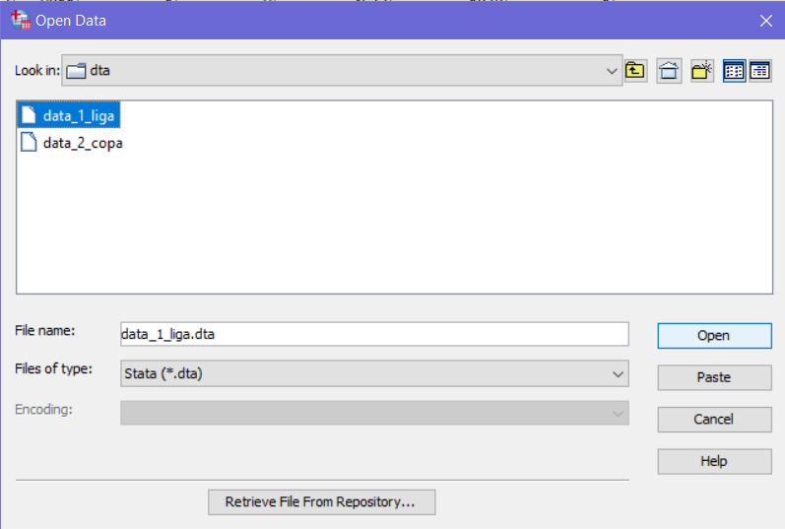
Table 1: Descriptive Statistics
This slide can be skipped
Import the Stata “data_1_liga” dataset from the “Moral Support Data” folder
5. Select “data_1_liga” from
the “dta” folder
6. Click “Open”

Slide 8
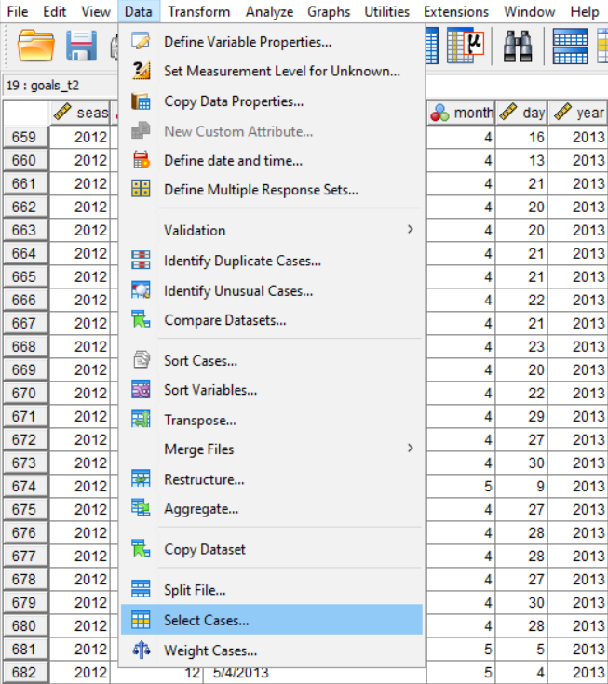
Table 1: Descriptive Statistics
Filter the dataset by the dummy variable “law” = 0 to only include matches played before the ban on visiting team fans
7. Click “Data”
8. Click “Select Cases…”

Slide 9
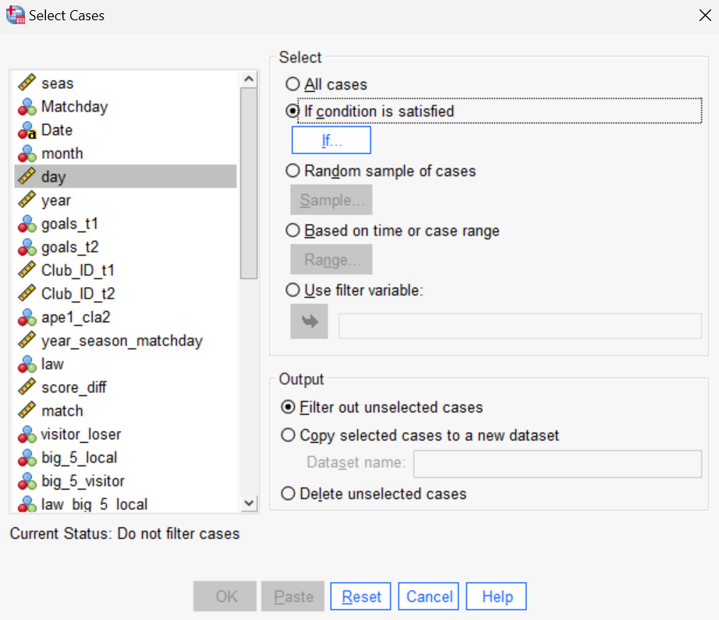
Table 1: Descriptive Statistics
Filter the dataset by the dummy variable “law” = 0 to only include matches played before the ban on visiting team fans
9. Select “If condition is satisfied”
10. Click “If”

Slide 10
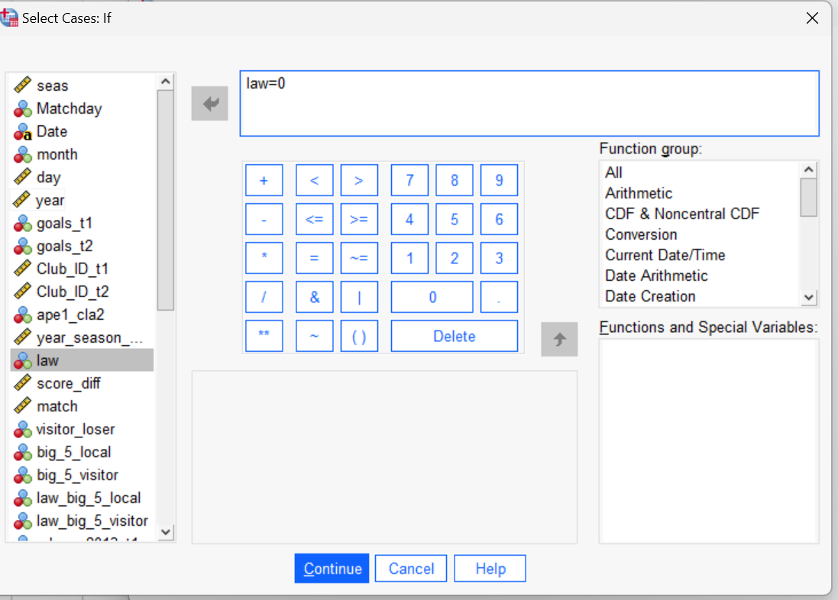
Table 1: Descriptive Statistics
Filter the dataset by the dummy variable “law” = 0 to only include matches played before the ban on visiting team fans
11. Double click the variable “[law]” from the left panel
12. Use the provided keypad to enter “= 0”
13. Click “Continue”

Slide 11
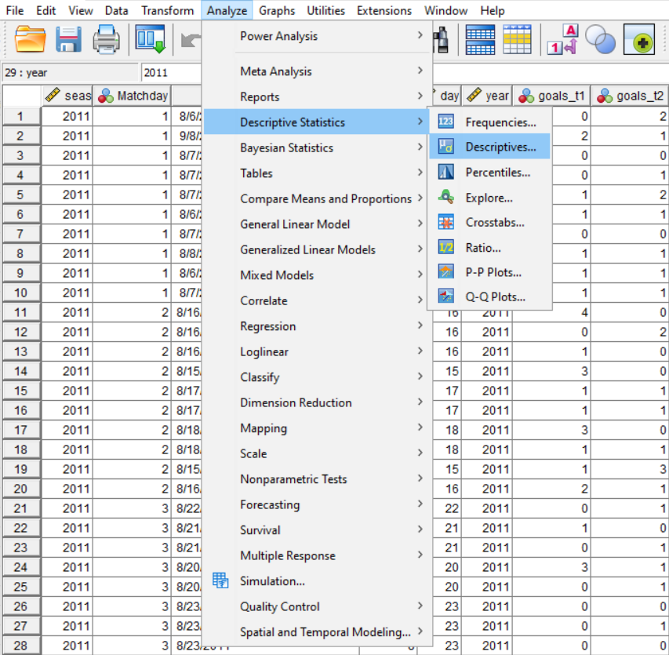
Table 1: Descriptive Statistics
Setup the descriptive statistics table for Before/Panel A
14. Click “Analyze”
15. Hover over “Descriptive Statistics”
16. Click “Descriptives…”

Slide 12
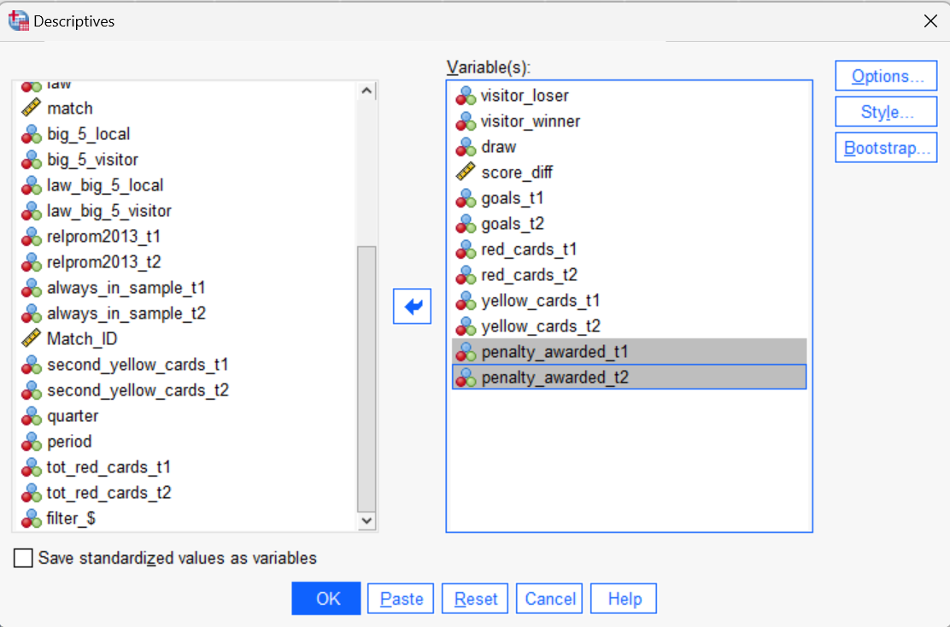
Table 1: Descriptive Statistics
Setup the descriptive statistics table for Before/Panel A
17. Double click all variables shown on the right from the left panel
18. Click “Options…”

Slide 13
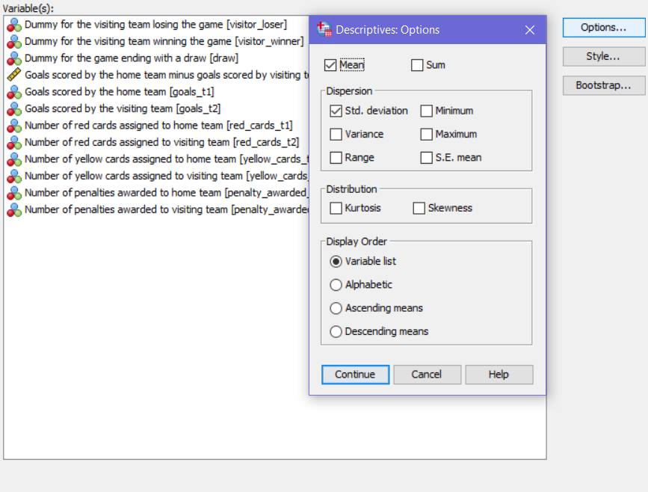
Table 1: Descriptive Statistics
Setup the descriptive statistics table for Before/Panel A
19. Deselect “Minimum” and “Maximum”
20. Click “Continue”

Slide 14
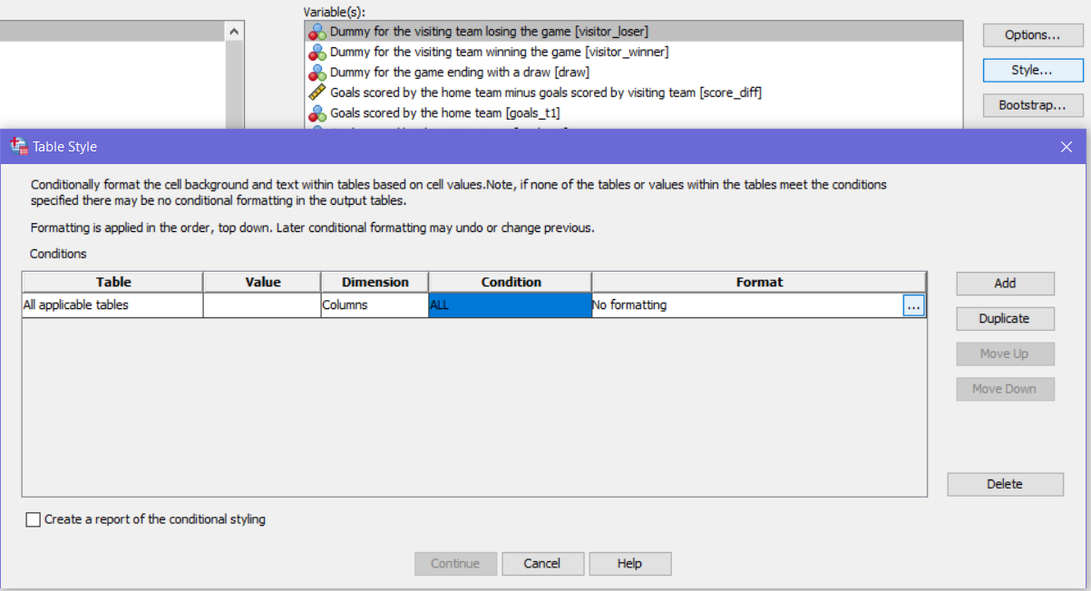
Table 1: Descriptive Statistics
Setup the descriptive statistics table for Before/Panel A
21. Click “Style…”
22. Click “Add” if there is nothing in the panel
23. Click the three dots under “Format”

Slide 15
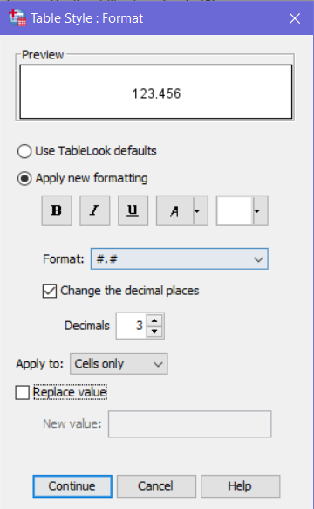
Table 1: Descriptive Statistics
Setup the descriptive statistics table for Before/Panel A
24. Select “Apply new formatting”
25. Select “#,#” under “Format:”
26. Check “Change the decimal places”
27. Use the up arrow or type “3” for “Decimals”
28. Click “Continue”

Slide 16
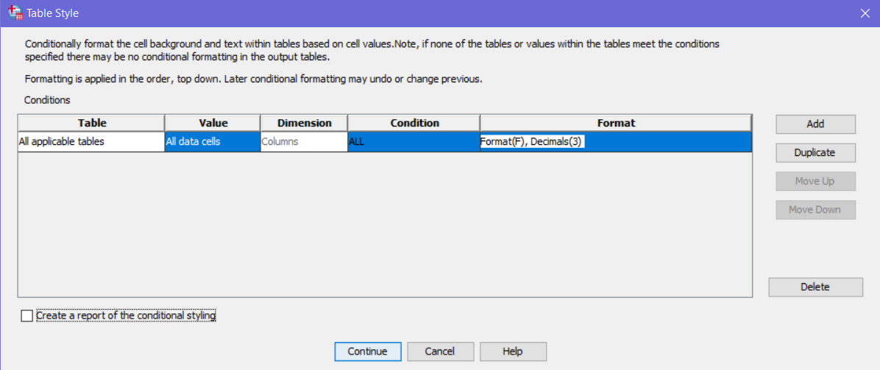
Table 1: Descriptive Statistics
Setup the descriptive statistics table for Before/Panel A
29. Select “All data cells” from the dropdown under “Value”
30. Click “Continue”

Slide 17
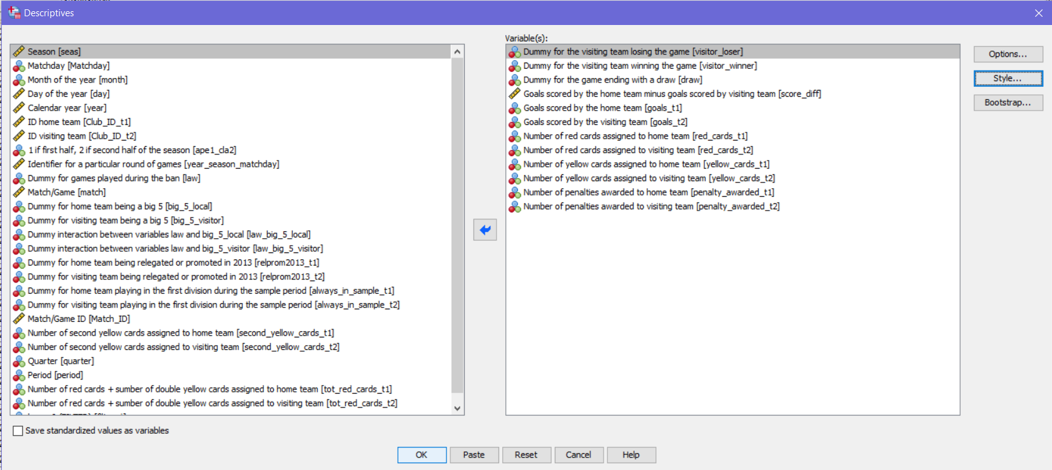
Table 1: Descriptive Statistics
Setup the descriptive statistics table for Before/Panel A
31. Click “OK” to create the table

Slide 18
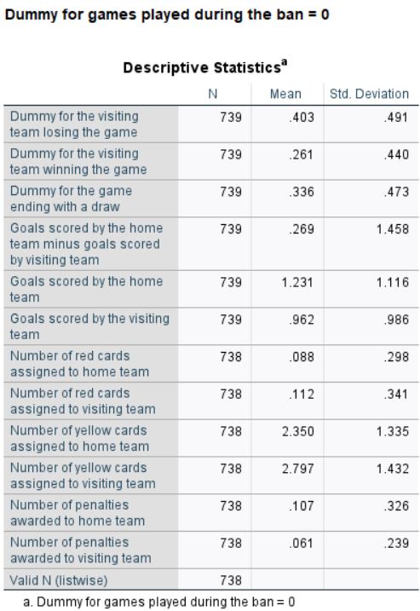
Table 1: Descriptive Statistics
Setup the descriptive statistics table for Before/Panel A
The output should look identical to the table on the left
Check values of your table with the ones “Before” for “Panel A” in Table 1

Slide 19
Table 1: Descriptive Statistics
Questions
1. From the output, what are the average number of red cards given to the home and visiting teams?

Slide 20
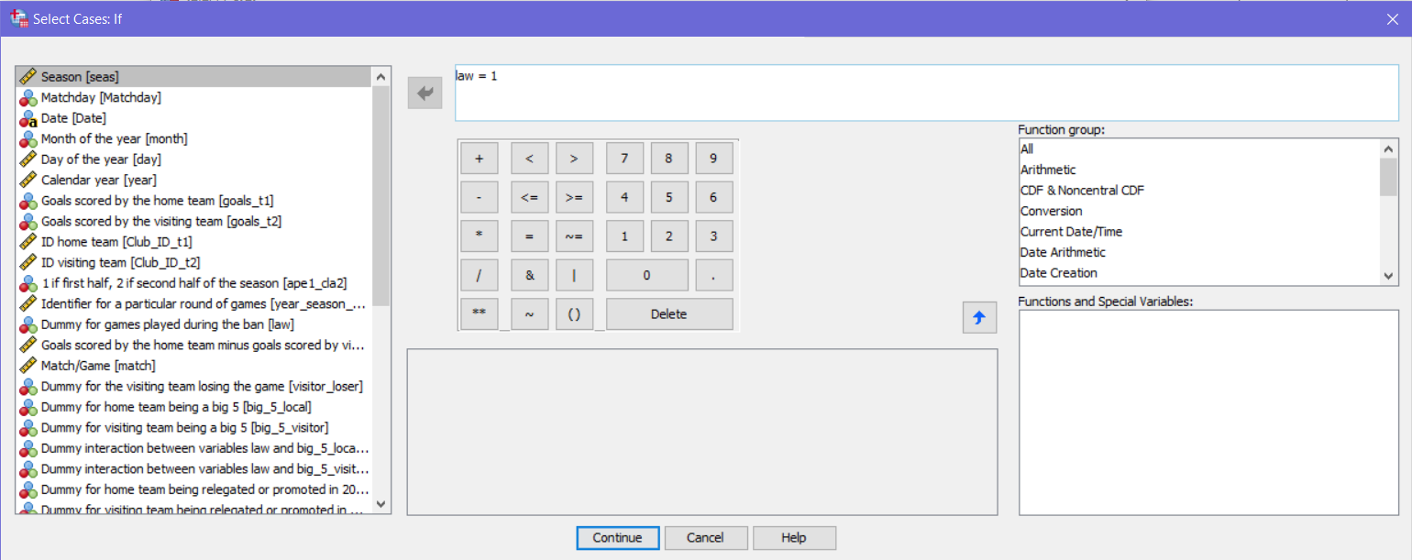
Table 1: Descriptive Statistics
Filter the dataset by the dummy variable “law” = 1 to only include matches played after the ban on visiting team fans
32. Repeat the steps from slide 8 to 10 but replace 0 with 1

Slide 21
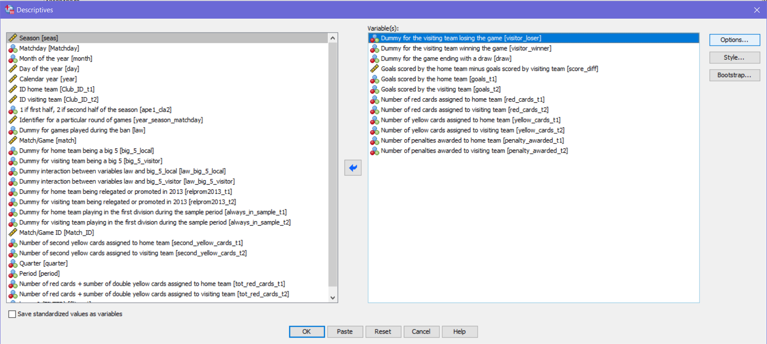
Table 1: Descriptive Statistics
Setup the descriptive statistics table for After/Panel A
33. Repeat the steps on slide 11 to run “Descriptives” again
34. All previous setup was saved so just click “OK” to produce the table

Slide 22
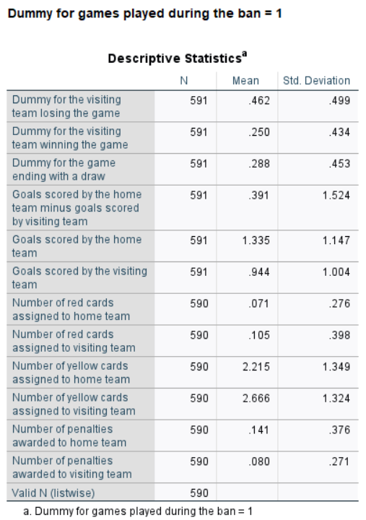
Table 1: Descriptive Statistics
Setup the descriptive statistics table for After/Panel A
The output should look identical to the table on the left
Check values of your table with the ones “After” for “Panel A” in Table 1

Slide 23
Table 1: Descriptive Statistics
Questions
2. From the output in SPSS, what is the average number of goals scored by the home and Visiting teams?
3. Keep in mind, this panel represents league games played after the ban on visiting team fans. How could we test if the number of goals scored by the home teams differs significantly before and after the ban?

Slide 24
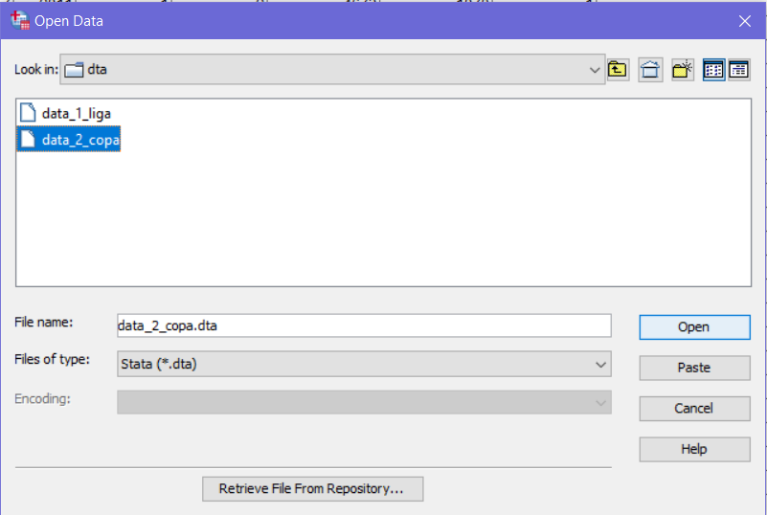
Table 1: Descriptive Statistics
Open the “data_2_copa” dataset
35. Repeat the process to open a SPSS data file mentioned in the note on slide 6
Note: The left image is again referencing how to import Stata files. You can simply open the data_2_copa SPSS dataset from your files like before.

Slide 25
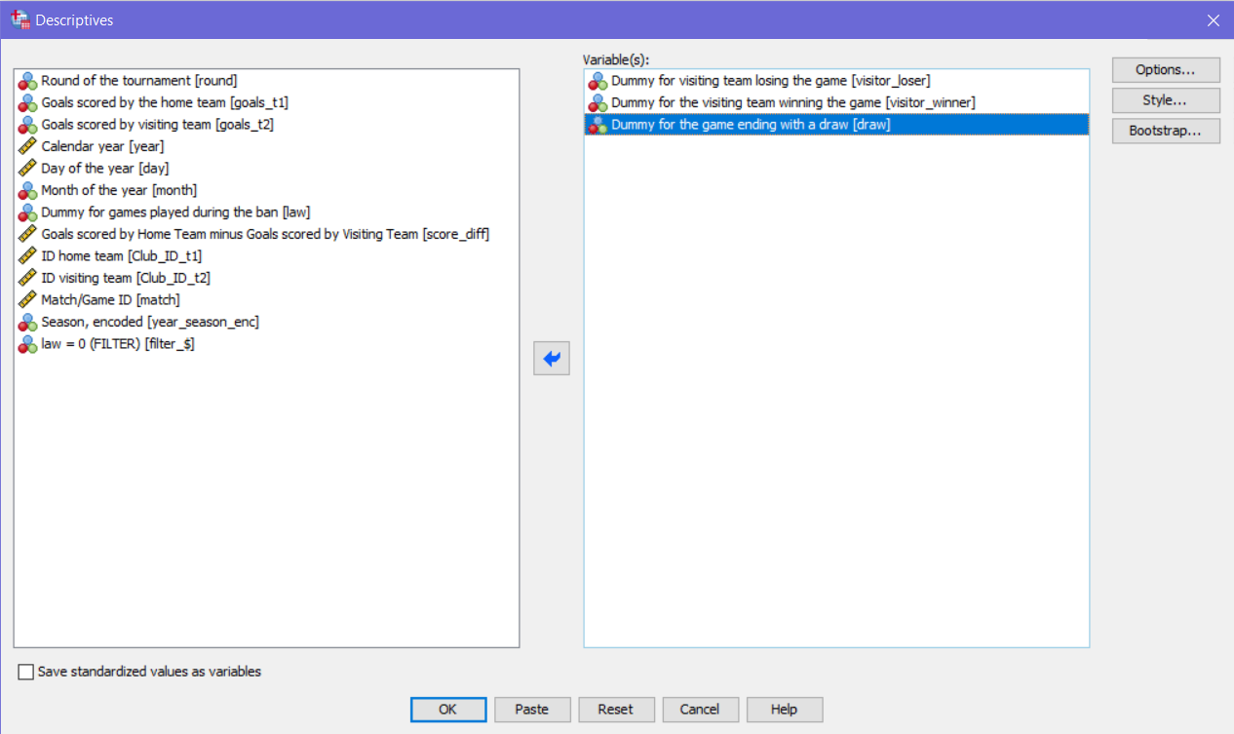
Table 1: Descriptive Statistics
Setup the descriptive statistics table for Before/Panel B
36. Repeat the steps from slides 8 through 10 to make “law” = 0
37. Repeat the steps from slides 11 through 16 to correctly format the table (ensure that your selected variables match the left image)
38. Click “OK”

Slide 26
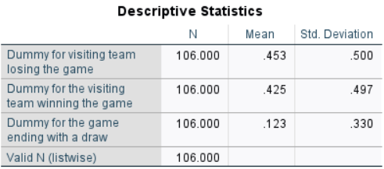
Table 1: Descriptive Statistics
Setup the descriptive statistics table for Before/Panel B
The output should look identical to the table above
Check values of your table with the ones “Before” for “Panel B” in Table 1

Slide 27
Table 1: Descriptive Statistics
Questions
4. What is the distribution of cup game outcomes before the ban (visiting team losing, winning, or a draw), and do these probabilities give us any insights into the overall balance of cup games?

Slide 28
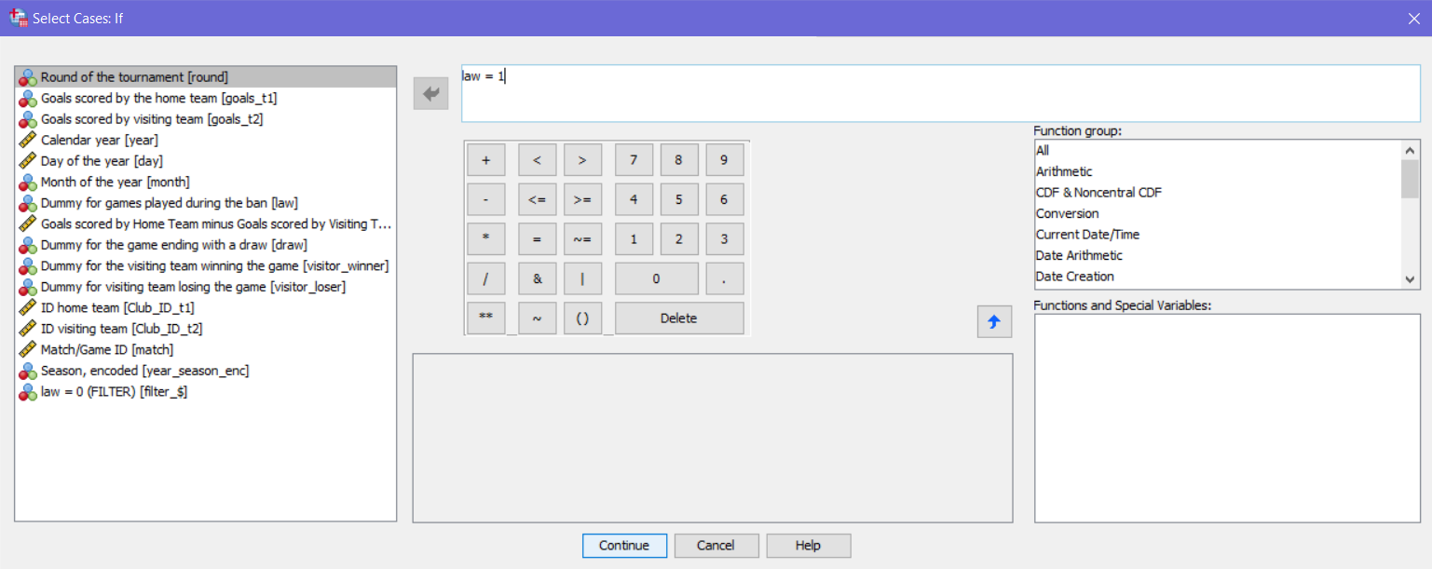
Table 1: Descriptive Statistics
Filter the dataset by the dummy variable “law” = 1 to only include matches played after the ban on visiting team fans
39. Replace “0” with “1” to only include data after the law
40. Click “Continue”

Slide 29
Table 1: Descriptive Statistics
Setup the descriptive statistics table for After/Panel B
41. Repeat the steps on slide 11 to run “Descriptives” again
42. Click “OK”

Slide 30
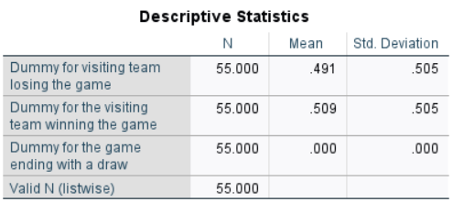
Table 1: Descriptive Statistics
Setup the descriptive statistics table for After/Panel B
The output should look identical to the table above
Check the values of your table with the ones “After” for “Panel B” in Table 1

Slide 31
Table 1: Descriptive Statistics
Questions
5. What are the outcomes (i.e. wins and loses) for visiting teams in Cup Games following the ban?
6. How may sample size affect the outcome distribution of cup games compared to league games? (Look at the N’s in Table 1)

Slide 32
Turn off Filter
Make sure to turn off the law = 1 filter from both datasets by selecting “All cases” or clicking “Reset” in the “Select Cases…” menu

Slide 33
Table 2: OLS Estimation
Now take a look at Table 2. Effects of the Ban on the Probability of Losing as a Visitor
This analysis uses the “data_1_liga” dataset
Model 1 utilizes basic OLS linear regression and Model 5 and 6 add controls using dummies for home and visiting team
Table 2 also reports robust standard errors. The following steps will present how to run a basic OLS linear regression and a more advanced OLS linear regression that includes robust standard errors

Slide 34
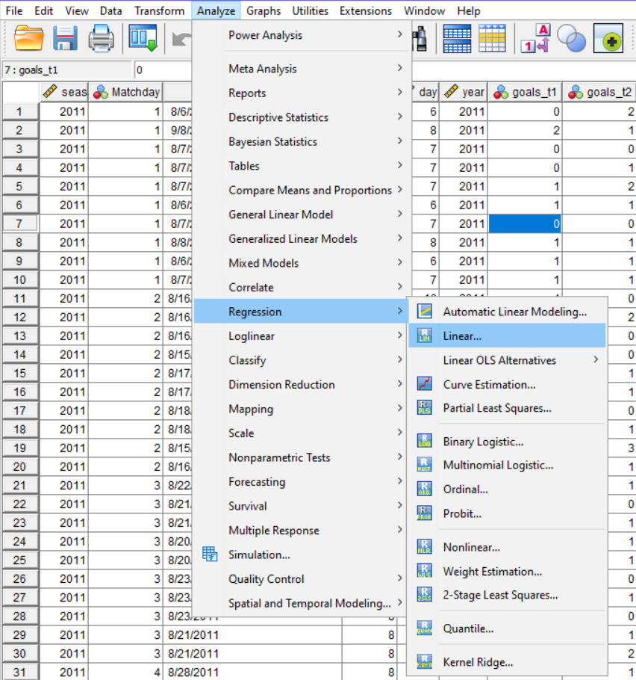
Table 2: OLS Estimation
Replicate Model 1
1. Click “Analyze”
2. Hover over “Regression”
3. Click “Linear…”

Slide 35
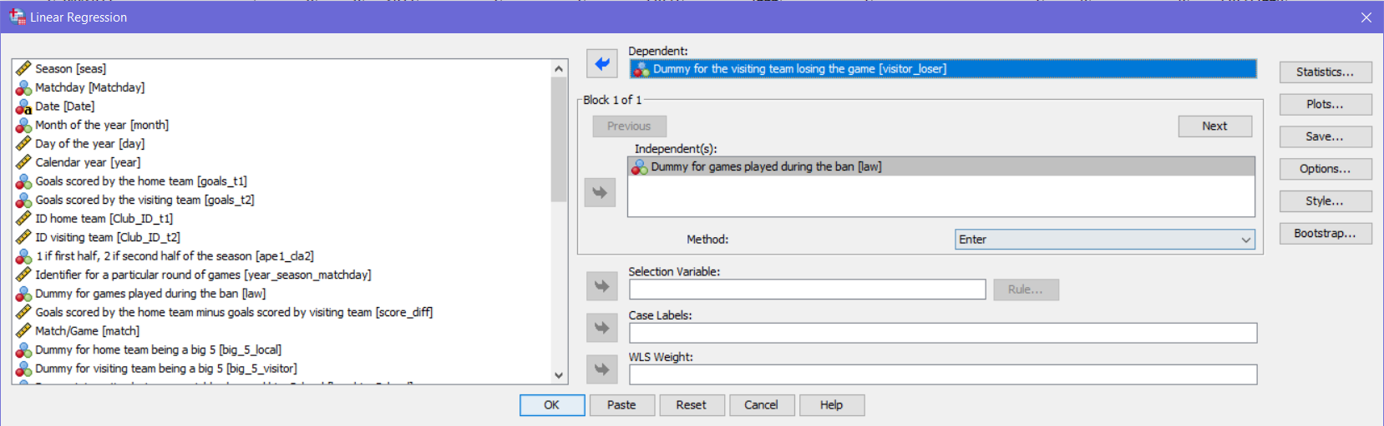
Table 2: OLS Estimation
Replicate Model 1
4. Add “visitor_loser” to the dependent variables
5. Add “law” as the independent variable
6. Click “Style…”

Slide 36
Table 2: OLS Estimation
Replicate Model 1
7. Repeat the steps from slides 14 to 16 and click “Continue”
8. Then click “OK” on the “Linear Regression” menu the to produce the results

Slide 37
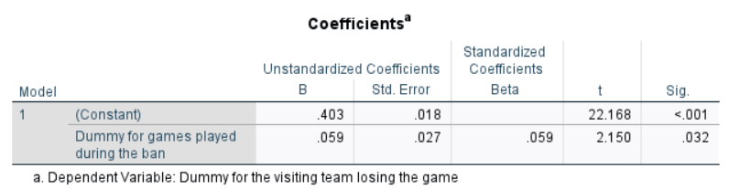
Table 2: OLS Estimation
7. Is the coefficient of the ban significant?
Replicate Model 1
The output should look identical to the table above
Check your results with Model 1 in Table 1 under “(1)”
Notice that the standard error is not robust

Slide 38
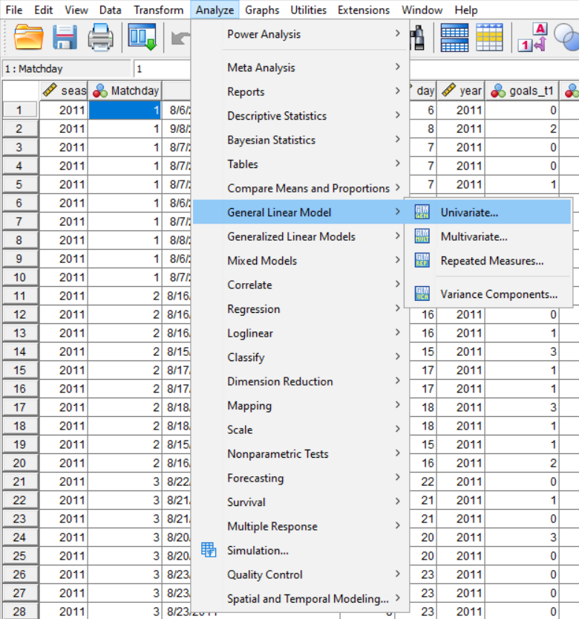
Table 2: OLS Estimation
Replicate Model 1 with robust standard errors
9. Click “Analyze”
10. Hover over “General Linear Model”
11. Click “Univariate”

Slide 39
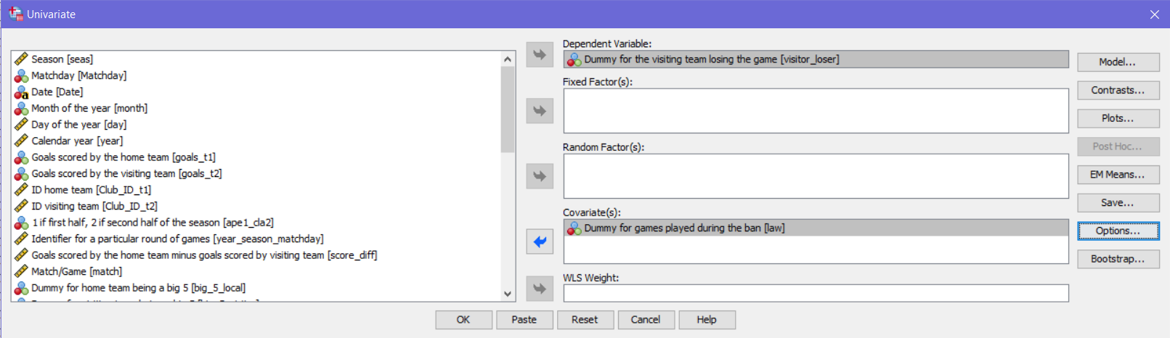
Table 2: OLS Estimation
Replicate Model 1 with robust standard errors
12. Add “visitor_loser” as the “Dependent Variable”
13. Add “law” to the “Covariates”
14. Click “Options…”

Slide 40
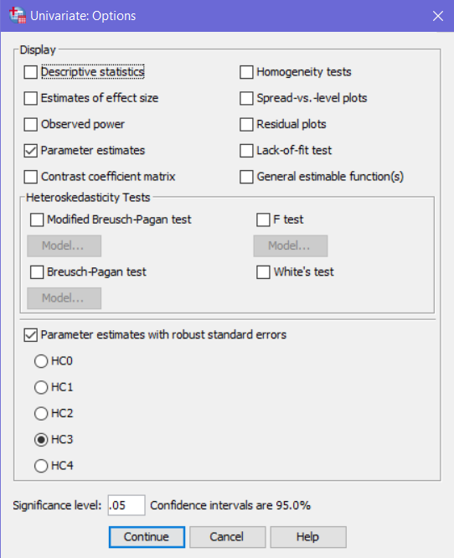
Table 2: OLS Estimation
Replicate Model 1 with robust standard errors
15. Select “Parameter estimates”
16. Select “Parameter estimates with robust standard errors”
17. Click “Continue”
18. Then click “OK” on the “Univariate” menu to produce the results

Slide 41
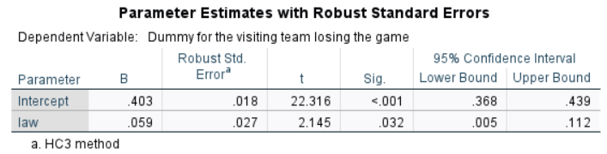
Table 2: OLS Estimation
Replicate Model 1 with robust standard errors
The output should now include robust standard errors
Notice that this method also produces the previous basic model
Check your results with Model 1 in Table 2 under “(1)”

Slide 42
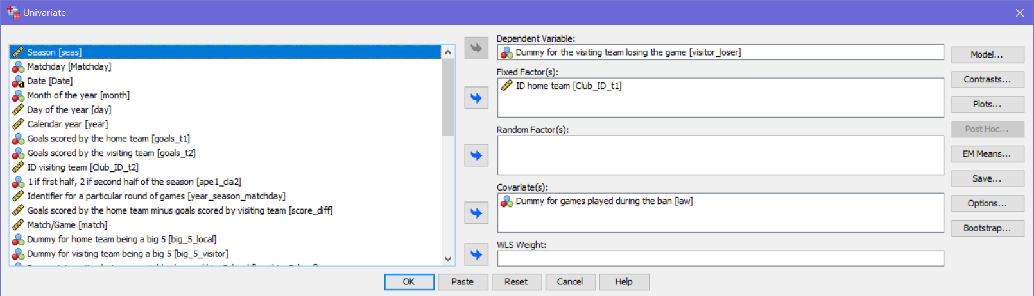
Table 2: OLS Estimation
Replicate Model 5 with robust standard errors and a control for home team
19. Repeat the steps from slide 38 to open the “Univariate” menu
20. Add “Club_ID_t1” to the “Fixed Factors”
21. Click “Model…”

Slide 43
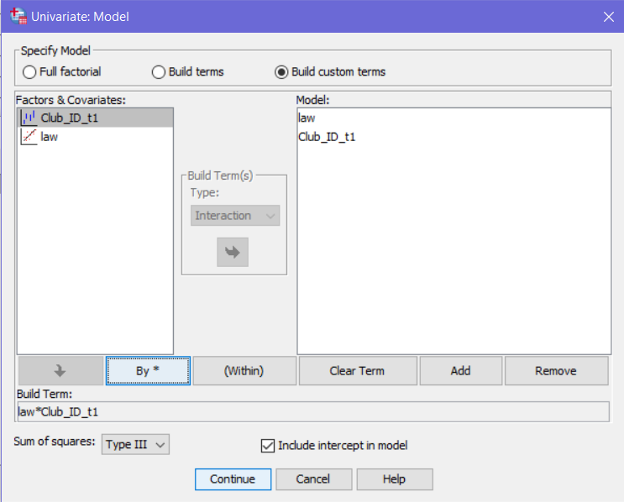
Table 2: OLS Estimation
Replicate Model 5 with robust standard errors and a control for home team
22. Select “Build custom terms”
23. Click and drag both variables to the right box
24. Click “law” on the left box then click the down arrow to add it to “Build Term”
25. Click “By *” then add “Club_ID_t1” to the “Build Term” like step 24
26. Click “Continue”
27. Click “OK” to run the analysis

Slide 44
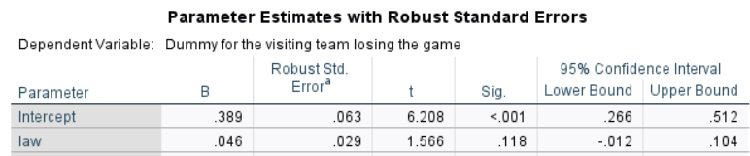
Table 2: OLS Estimation
Replicate Model 5 with robust standard errors and a control for home team
The output should have an identical coefficient for law as the paper
Note that the computed standard errors may not always match the paper
Check your results with Model 5 in Table 2 under “(5)”

Slide 45
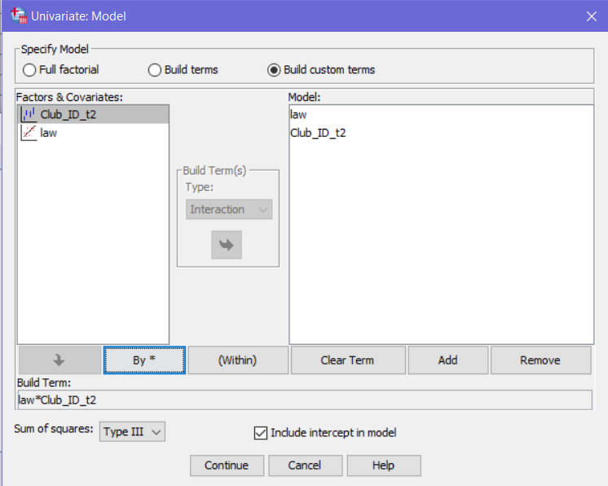
Table 2: OLS Estimation
Replicate Model 6 with robust standard errors and a control for Visiting team
28. Repeat the steps on slides 42 and 43 but replace “Club_ID_t1” with “Club_ID_t2”

Slide 46
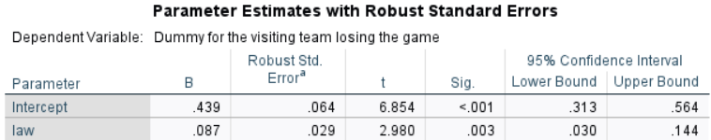
Table 2: OLS Estimation
Replicate Model 6 with robust standard errors and a control for home team
The output should have an identical coefficient for law as the paper
Check your results with Model 6 in Table 2 under “(6)”

Slide 47
Table 4: OLS Estimation
Now take a look at Table 4. Counterfactual Test: Main Regression Specifications with Cup Games
You will use the “data_2_copa” dataset for this table
The dataset is the only difference for this analysis
You will be replicating Model 1, 5, and 6 using the “Univariate” method
The next slide will contain the correct output for all three models
1. Repeat the steps on slides 38 through 45 and check the results with the values under “(1)”, “(5)”, and “(6)” in Table 4

Slide 48
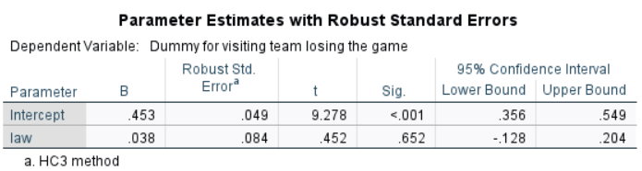
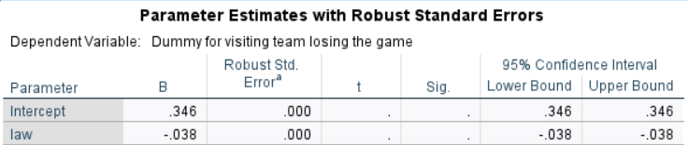
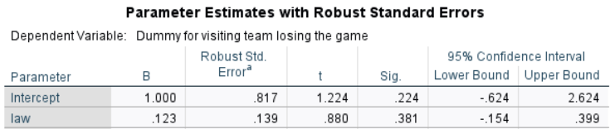
Table 4: OLS Estimation
(1)
(5)
(6)

Slide 49
Table 5: OLS Estimation
Now take a look at Table 5. Effect of the Ban on Referees’ Decisions
You will be replicating Model 1, 5, and 6 for Panel B and C
Each Panel has two different dependent variables for Home and Visiting
Instead of manually repeating the previous steps, you will be using a SPSS Syntax file to simply run each regression with the swapped dependent variables for each regression
The code for replicating Models 1, 5 and 6 for the home team players in Panel B: Red Cards and Panel C: Penalties Awarded is provided in the “Colella Table 5 Replication Syntax” file.
This analysis uses the “data_1_liga” dataset. Close the “data_2_copa” dataset for the remaining tables

Slide 50
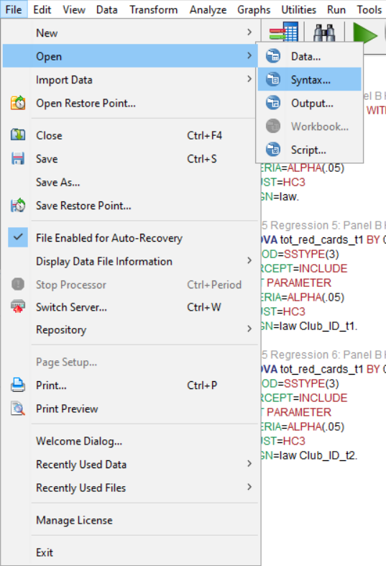
Table 5: OLS Estimation
Run the Syntax file for Models 1, 5, and 6 for Panel B Home Team
Click “File” then hover over “open” and click “Syntax…”
Open the file named
“Colella Table 5 Replication Syntax”

Slide 51
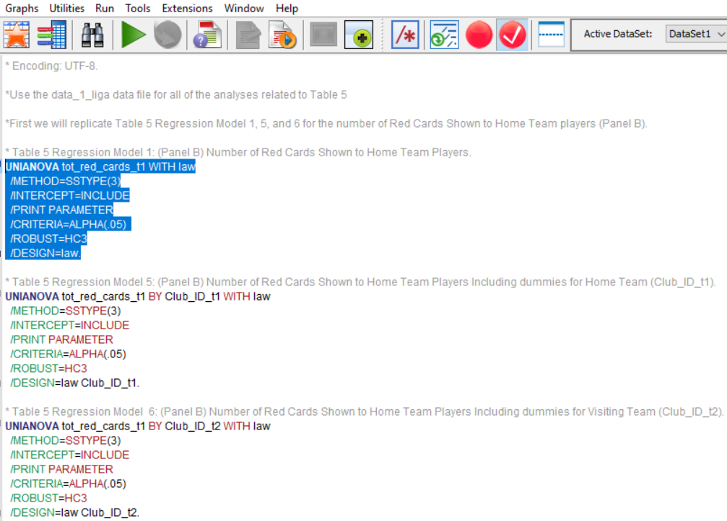
Table 5: OLS Estimation (Models 1,5, 6 for Panel B Home Teams)
Run the Syntax file for Models 1, 5, and 6 for Panel B Home Team
3. Highlight the first statement for Regression Model 1
4. Click the green “Run Selection” button
5. Repeat steps 3 and 4 to run Regression Models 5 and 6. Then crosscheck with the next slide and under “(1)”, “(5)”, and “(6)” for Panel B in Table 5

Slide 52
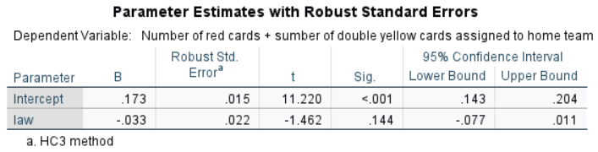
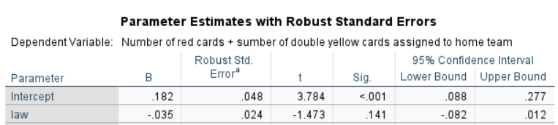
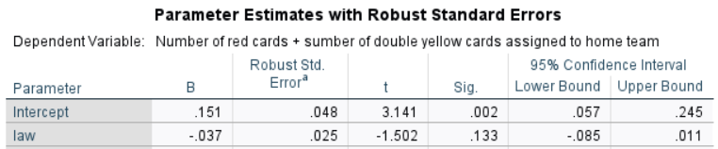
Table 5: OLS Estimation (Models 1,5, 6 for Panel B Home Teams)
(1)
(5)
(6)

Slide 53
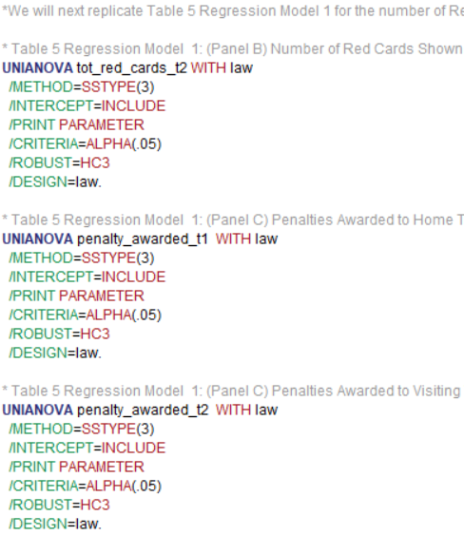
Table 5: OLS Estimation (Model 1 for Panels B (visit) & C (Home & Visit)
Replicate Model 1 for Panel B Visiting and Panel C Home and Visiting
6. Run each regression as before and crosscheck your results with the next slide and under “(1)” for Panel B Visiting and Panel C Home and Visiting in Table 5

Slide 54
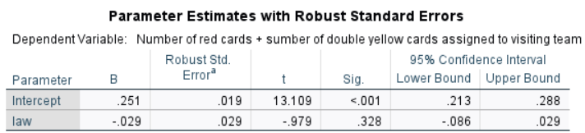
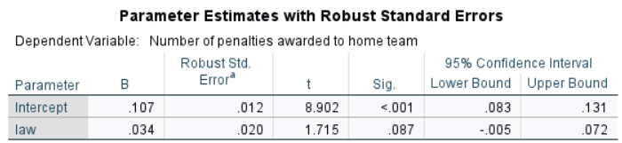
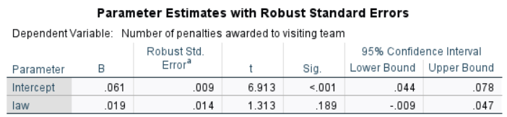
Table 5: OLS Estimation
(1) Panel B Visiting
(1) Panel C Home
(1) Panel C Visiting

Slide 55
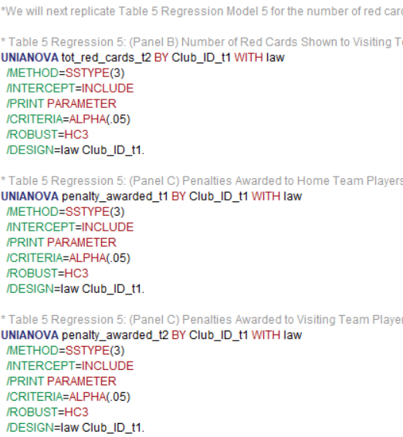
Table 5: OLS Estimation (Model 5 for Panels B (visit) & C (Home & Visit)
Replicate Model 5 for Panel B Visiting and Panel C Home and Visiting
7. Run each regression as before and crosscheck your results with the next slide and under “(5)” for Panel B Visiting and Panel C Home and Visiting in Table 5

Slide 56
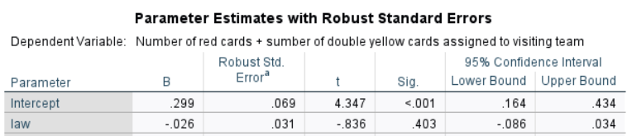
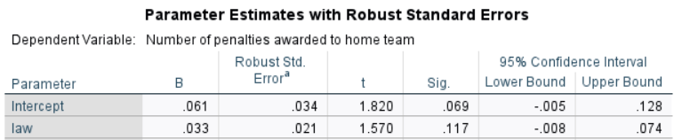
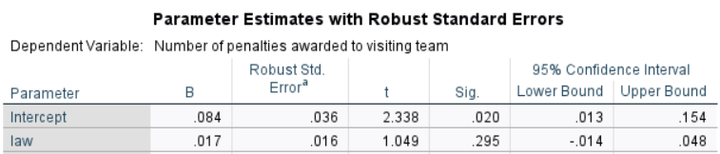
Table 5: OLS Estimation
(5) Panel B Visiting
(5) Panel C Home
(5) Panel C Visiting

Slide 57
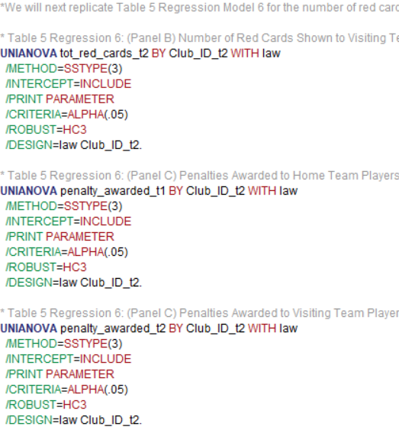
Table 5: OLS Estimation (Model 6 for Panels B (visit) & C (Home & Visit)
Replicate Model 5 for Panel B Visiting and Panel C Home and Visiting
7. Again, run each regression and crosscheck your results with the next slide and under “(6)” for Panel B Visiting and Panel C Home and Visiting in Table 5

Slide 58



Table 5: OLS Estimation
(6) Panel B Visiting
(6) Panel C Home
(6) Panel C Visiting

Slide 59
Table 6: OLS Estimation
Now take a look at Table 6. Heterogeneous Effects: The Big-5
Table 6 uses multivariate regression with more than one independent variable, unlike the previous models
Four of the variables are interaction terms “Visiting big 5 * home Big 5” and “Visiting big 5 * home Big 5 * ban” will need to be created and “Visiting team Big 5 * ban” and “Home team Big 5 * ban” are already in the dataset
You will only be replicating the variables used in Model 1, 5, 6, and 7 using the basic regression method from Table 1, meaning that Only Model 1 will match the paper’s output
The objective is to interpret the changes in the coefficients between models

Slide 60

Table 6: OLS Estimation
Create the two interaction terms
1. Click “Transform”
2. Click “Compute Variable…”

Slide 61

Table 6: OLS Estimation
Create the two interaction terms
3. Under “Target Variable” name the new variable “visitbig5_homebig5”
4. Add “big_5_visitor” then click “*” on the keypad and add “big_5_local”
5. Click “OK”

Slide 62

Table 6: OLS Estimation
Create the two interaction terms
6. Repeat the steps on slide 60 to return to the “Compute Variable” menu
7. Under “Target Variable” name the new variable “visitbig5_homebig5_ban”
8. Repeat step 4 on slide 61 then click “*” on the keypad and add “law”
9. Click “OK”

Slide 63

Table 6: OLS Estimation
Run OLS Regression with Model 1 Variables
10. Setup the regression according to the above image
11. Ensure that the “Style” menu is adjusted to report 3 significant digits as done for previous regressions then click “OK”

Slide 64
Table 6: OLS Estimation
Run OLS Regression for Models 5, 6, and 7
Repeat the previous regression steps for step 12 through 14
12. Replicate Model 5 by removing “big_5_local” from the independent variables
13. Replicate Model 6 by adding “big_5_local” back and removing “big_5_visitor” from the independent variables
14. Replicate Model 7 by removing “big_5_local” from the independent variables again
Crosscheck your results for each model with the next slide

Slide 65




Table 6: OLS Estimation
(1)
(5)
(6)
(7)

